Slide 1



SMART HOME
AUTOMATION
Aditya Chauhan
Aditya Yadav

Slide 2
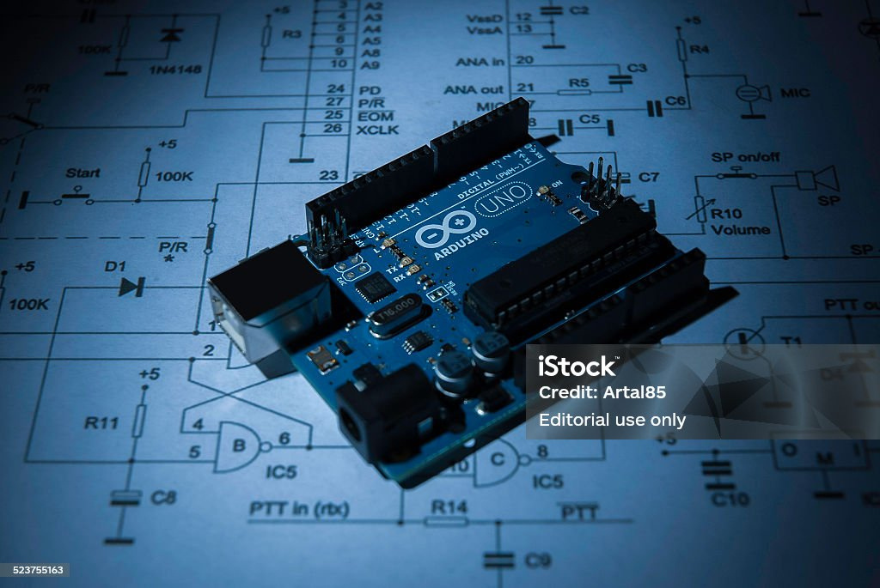

COMPONENTS USED
Arduino UNO
LED
Resistors
Temperature Sensor
Buzzer
Jumper Wires
Bread Board
Micro Switch
Microphone

Slide 3
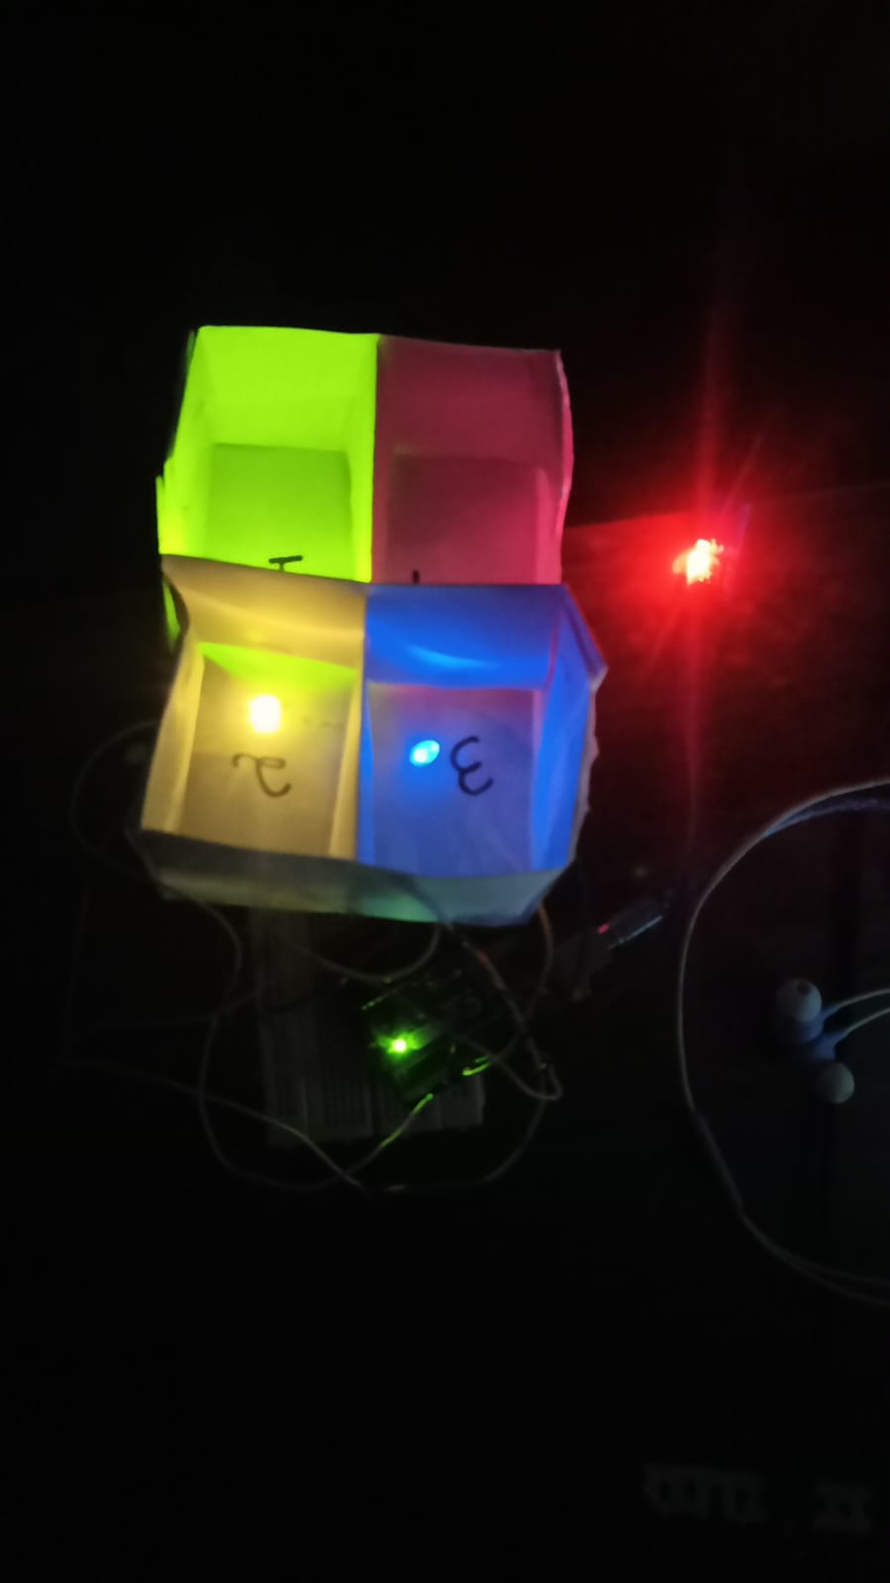

ABOUT THE PROJECT
The whole system represents a house consisting of 4 rooms where most of the digital work is voice automated.
The various electronic items such as bell, lights etc. can be turned on just by giving voice commands
Also, a security system has been installed the house .In case of fire, all the lights of the house start blinking vigorously and the buzzer riings informing the dwellers to evacuate.

Slide 4
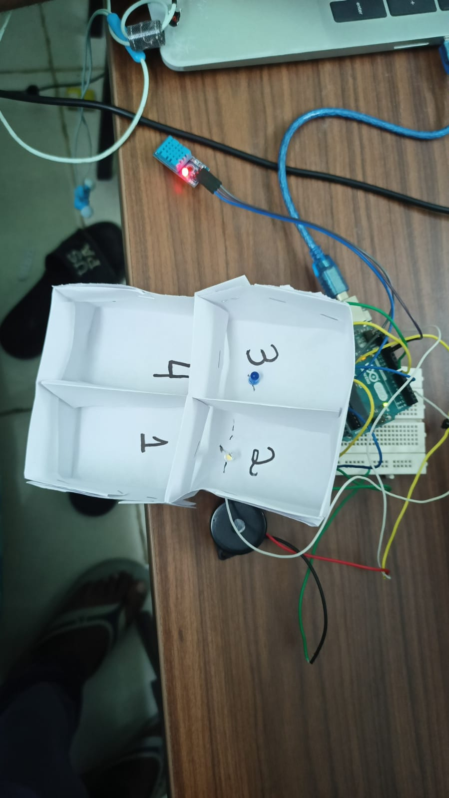



Slide 5
else if(keyword.equals("on all led")){
digitalWrite(led1,HIGH);
digitalWrite(led2,HIGH);
digitalWrite(led3,HIGH);
digitalWrite(led4,HIGH);
}
else if(keyword.equals("off led 1")){
digitalWrite(led1,LOW);
}
else if(keyword.equals("off led 2")){
digitalWrite(led2,LOW);
}
else if(keyword.equals("off led 3")){
digitalWrite(led3,LOW);
}
else if(keyword.equals("off led 4")){
digitalWrite(led4,LOW);
}
else if(keyword.equals("off all led")){
digitalWrite(led1,LOW);
digitalWrite(led2,LOW);
digitalWrite(led3,LOW);
digitalWrite(led4,LOW);
}
for (int frequency = 2000; frequency
>= 0; frequency -= 50) {
tone(buzzerPin, frequency);
delay(50);}
else if(keyword.equals("Thank")){
noTone(buzzerPin);
}
// }
float temperature = dht.readTemperature();
if (!isnan(temperature)) {
Serial.print("Temperature: ");
Serial.print(temperature);
// Serial.println(" °C");
if (temperature > temperatureLimit) {
digitalWrite(buzzerPin, HIGH);
digitalWrite(led1,HIGH);
digitalWrite(led2,HIGH);
digitalWrite(led3,HIGH);
digitalWrite(led4,HIGH);
delay(100);
digitalWrite(led1,LOW);
digitalWrite(led2,LOW);
digitalWrite(led3,LOW);
digitalWrite(led4,LOW);
delay(100);
}
else {
digitalWrite(buzzerPin, LOW);
}
}
else {
Serial.println("Error reading temperature!");
}
}
#INCLUDE <DHT.H>
#define DHTPIN 12
#define DHTTYPE DHT11
int buzzerPin = 13;
float temperatureLimit = 32.0;
DHT dht(DHTPIN, DHTTYPE);
#define led1 2
#define led2 4
#define led3 7
#define led4 8
void setup() {
Serial.begin(9600);
pinMode(led1,OUTPUT);
pinMode(buzzerPin, OUTPUT);
dht.begin();
}
void loop() {
// if(Serial.available()>0){
String keyword = Serial.readStringUntil('\n');
keyword.trim();
if (keyword.equals("on led 1")) {
digitalWrite(led1,HIGH);
}
else if(keyword.equals("on led 2")){
digitalWrite(led2,HIGH);
}
else if(keyword.equals("on led 3")){
digitalWrite(led3,HIGH);
}
ELSE IF(KEYWORD.EQUALS("ON LED 4")){
DIGITALWRITE(LED4,HIGH);}

Slide 6
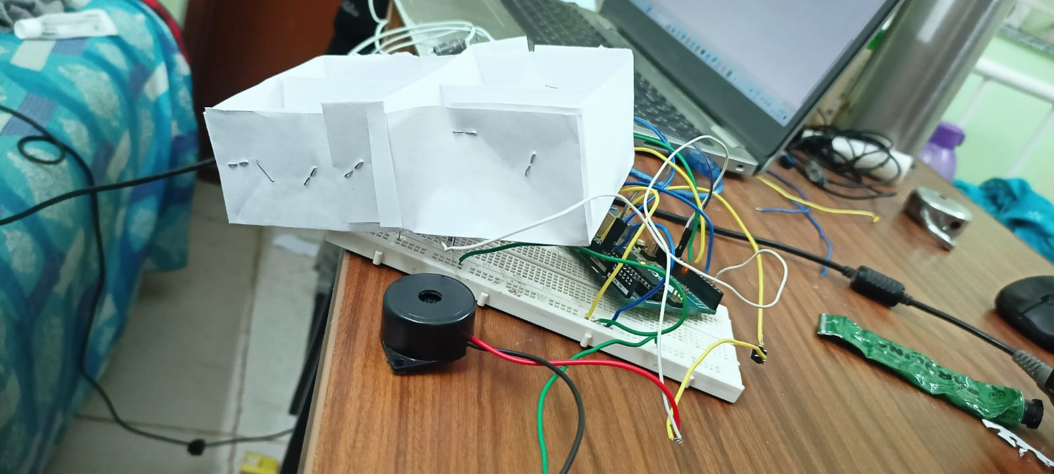
WORKING
The system upon receiving the speech, converts it into text using a package named SpeechRecognition , and this information is stored into the variable named source.
Ambient noices are then removed and the clear text is then stored in another variable named audio.
This text in the variable audio is then recognized using Google .
after that, specific keywords are selected from this text and stord in variable keyword.
Using this keyword , we traverse in the if else statements and try to match it with some commonly uesd words in this contextt.
When the text in keeyword satisfactorily matched with prefed words, then our arduino functioning begins.
After successfully uploading and compiling the given code, our commands get exexuted..Also, the user has the right to multiple commans in a sigle go because everyhint is being executed in a while loop.

Slide 7

THANK YOU
2201CS07
2201CS08

